Slide 1
The Importance Of Knowing The History Of Your Research Project
Sooad Al-daihan

Slide 2
Outline
Research Definition
Research Problem
Research Process
Importance of Literature Review
Summary
Outcomes
You will be able to:
Clarify your ideas and the gap of knowledge of your research interest
Find data related to your work and research methods to conduct your project
Identify potential issues with the work you plan to do

Slide 3
The Generation & Communication Of Research Knowledge
Information Is Generated From
Research Is
Critical evaluation
Interpretative work
research
conducted by individuals, institution and association
Communicated Via
Conference Paper Journals Lectures Meetings Reports Seminars Thesis
Accessed through
Electronic media Hardcopy
Notes:
This figure provides an overview showing the main sources of knowledge and tools by which most of it is organized

Slide 4
Research is a combination of both experience and reasoning and must be regarded as the most successful approach to the discovery of truth. (Cohen and Manion, 1994)
“Nothing contributes to the quality of your research more than your commitment to it.”
“Readers of research papers don’t want just information; they want the answer to a question worth asking.” (Booth et al, 1994)

Slide 5
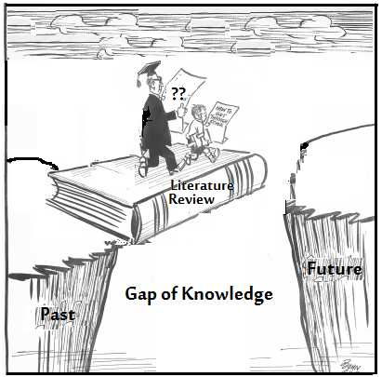

Slide 6
What is Research?
Research Can Be Define As:
The systematic investigation into the study of materials, sources etc. in order to establish facts and reach new conclusions (Oxford Encyclopaedic English Dictionary).
An endeavour to discover new or collate old facts etc. by the scientific study of a subject or by a course of critical investigation (OEED, 1991).
Research is a procedure by which we attempt to find systematically, and with the support of demonstrable fact, the answer to a question or the resolution of a problem (Leedy, 1989).
The systematic, controlled, empirical and critical investigation of hypothetical propositions about presumed relations among natural phenomena. (Kerlinger, 1970).

Slide 7
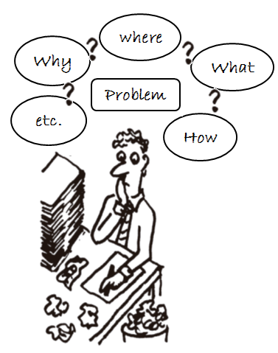
Research Problem
The shortest way of describing the contents of this lecture is to say that it provides a starting point for your research efforts.
An essential early step in the process of research is to find a research problem.
You must have one example of problem statement from any journal paper or research paper within your field
Sitting down to read a 50 to 100 literature reviews/ papers not a simple task but…..

Slide 8
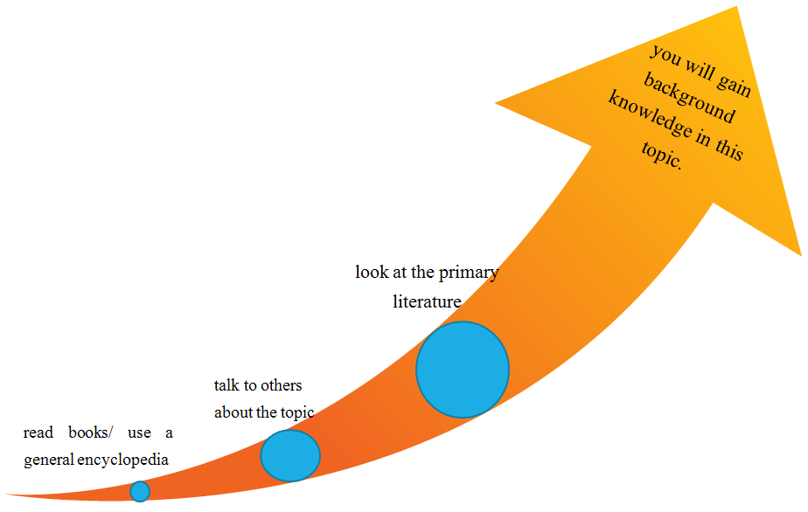
Narrowing your topic is not done by following a step-by-step formula.
It is integrated with library/net research.
One way to narrow your topic is to learn more about it – expose yourself to background information.
As you begin to understand more about your topic, you will see better where you might want to go.

Slide 9
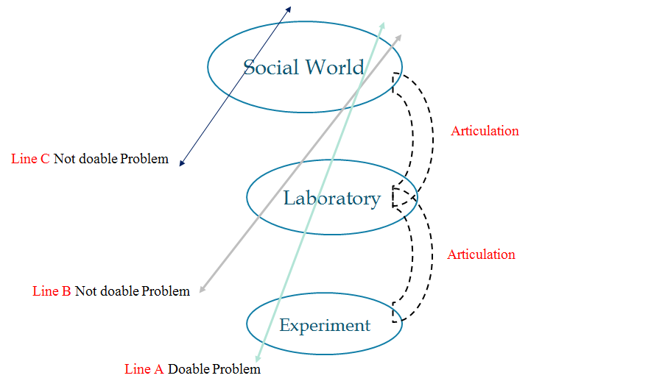
Aligning level of work organization to construct doable problem

Slide 10
Risk of mortality/ morbidity
Economics
Social issue
Epidemiology Experiments
Clinical Experiments
Cancer research
Molecular Biology Experiments
Research Centers
Laboratory
Hospitals
Biomedical Experiments
Universities

Slide 11
Your Research Area And Question: Your “ Slice Of The Cake”
Whole Cake: Someone else can ask questions about or explore this area, or you might later.
Boundaries: Issues And Areas You Are Now Exploring
THE RESEARCH CAKE
Research questions usually stem from practice and serve to inform and develop practice.

Slide 12
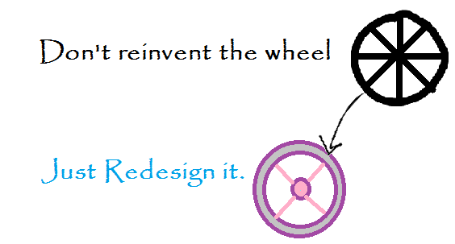
There are two basic considerations that must be honored in finding a research problem:
It must represent an actual problem somewhere - a "pain point" for some practitioner of some useful activity
It must be something that has not yet been found, obviously. Remember the perceived "hole" in the field of knowledge.

Slide 13
Conducting any type of research project without conducting a literature review can be likened to travelling to a strange and exotic country but never coming out of your hotel room.

Slide 14
To develop a strong research question from your ideas, you should ask yourself the following questions:
Do I know the field and its literature well?
What are the important research questions in my field?
What areas need further exploration?
Could my research fill a gap? Lead to greater understanding?
Has a great deal of research already been conducted in this topic area?
Has this study been done before? If so, is there room for improvement?
Is the timing right for this question to be answered? Is it a hot topic or is it becoming obsolete?
Most importantly, will my research attract the interest of a potential thesis director?

Slide 15
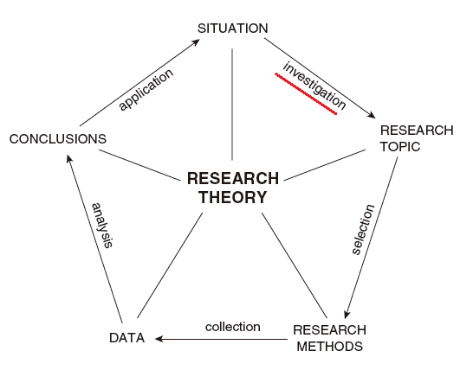
Research Process
A simple summary of the relationships between five main elements of the research process can be mapped.
Is it clear to you how progress is achieved, and at which point you can enter the system?
The knowledge gained and questions raised at each turn provide the basis for the next cycle.
History of your research

Slide 16
Presentation
Validation
Sequence of Research Stages
Contribution
Modeling
Problem Definition
Literature Review

Slide 17
An effective literature review (sometimes called “background and significance” or “theoretical orientation”) is essential to every successful proposal/research, from art history to chemical engineering, and from early graduate study fellowships and small grants to completion fellowships and postdocs. (Bitting, 2012)

Slide 18
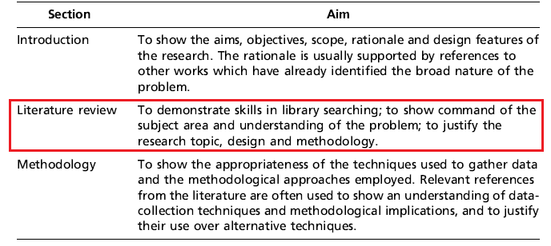
Some Sections commonly found in research proposal and thesis

Slide 19
What is a Literature Review?
A literature review is a synopsis of other research. Moreover, it is a critical appraisal of other research on a given topic that helps to put that topic in context (Machi and McEvoy, 2009).
Whatever the approach, the purpose of the review is to provide an analysis and synthesis of all the available literature on a given subject in a critical fashion. This then allows for further understanding of the subject in the context of what is already known. Furthermore, it can lead to the development of new research questions.

Slide 20
What are the main questions and problems that have been addressed to date?
What are the key sources?
Literature search and review on your topic
What are the key theories, concepts and ideas?
What are the major issues and debates about the topic?
How is knowledge on the topic structured and organized?
How have approaches to these questions increased our understanding and knowledge?

Slide 21
1. Select a topic
2. Search and choose the literature
3. Analyze the literature
4. Start your research methodology and collect Data
5. interpret your data compare to the literature
Literature Review Process

Slide 22
The Importance of Reviewing the Literature
The importance of the literature review is directly related to its aims and purpose.
Nursing and allied health disciplines contain a vast amount of ever increasing literature and research that is important to the ongoing development of practice. The literature review is an aid to gathering and synthesizing that information.
The purpose of the literature review is to draw on and critique previous studies in an orderly, precise and analytical manner. The fundamental aim of a literature review is to provide a comprehensive picture of the knowledge relating to a specific topic.
For example, if one is proposing to undertake a research project, then the purpose of the literature review is to situate that project in its relevant context or background. It does this by drawing on previous work, ideas and information.
In addition, a good review will extract and critically evaluate the pertinent findings and issues that have emerged from previous work (Hart, 2010). By doing so, it provides justification for the proposed research and demonstrates a thorough grasp of background knowledge.

Slide 23
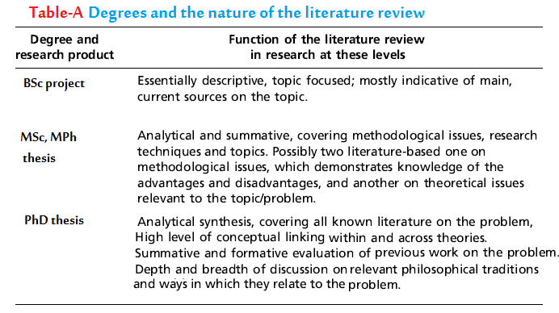
All reviews, irrespective to the topic, are written from a particular perspective and standpoints of the reviewers.
A major product of academic programs in postgraduate education is the thesis. Table below provides a summary of the function and format of the literature review at different postgraduate level.

Slide 24
Why is the literature review so important?
A specific and reproducible method is used to identify, select, and appraise all the studies of a previously agreed level of quality that are relevant to a particular question. The results of the studies are then analyzed and summarized. A good research synthesis can generally give us the most reliable estimate of the effectiveness of a specific intervention, and it can identify gaps in our knowledge that require further research. It can also give us a sense of the strength of the available evidence and the quality of the studies.
Light and Pillemer (1984) have written that ‘disagreements among findings are valuable … [and that] conflicts can teach us a lot’.

Slide 25
Background Analysis Template
Author(s) | Year | Research Title | Focus Area | Research design | Variable(s) | Hypothesis | Finding | Suggestion for further research

Slide 26
Conclusion
By undertaking a literature review you are able to critically summarize the current knowledge in the area under investigation, identifying any strengths and weaknesses in previous work, so helping you to identify them in your own research and thus eliminate the potential weaknesses, whilst bringing to the fore the potential strengths.
Furthermore, it can help to inspire and generate new ideas by highlighting inconsistencies in current knowledge (Aveyard, 2010).
Remember, a well defined and a structured research problem is the heart of the research project. Vague research problem is the weakest point in your research.

Slide 27
References
Arguing For The Importance Of Your Research: The Literature Review; October 24, 2012 By Kelsey Bitting
Constructing `Do-able' Problems In Cancer Research: Articulating Alignment (1987) Joan H. Fujimura.
Light Rj, Pillemer Db (1984). Summing Up. Cambridge: Harvard University.
Robin Kiteley And Chris Stogdon 2014. Literature Reviews In Social Work.
Aveyard, H. (2010) Doing a Literature Review in Health and Social Care: A Practical Guide. Maidenhead: Open University Press.

