Slide 1
Analysis of data, breaking problems down into manageable units
بـرنـامـج مهـارات البـحـث الـعـلمـي الثامن
لطالبات الدراسات العليا -1436/1437 هـ

Slide 2
Outline
Data Types
Data Analysis
Positive vs Negative results
Examples
Outcomes
You will be able to:
Distinguish between Quantities and Qualitative data.
Dealing with the three Cs: Coding, Categorizing, and Concepts
Dealing with the negative results similar to positive one.

Slide 3
Have researchers really discovered a ‘new miracle drug to cure nine in 10 cancers’?

Slide 4
Data analysis can be said to be:
“the process of breaking down, examining, comparing,
conceptualizing, and categorizing data” (Strauss &Corbin, 1998).
As data analysis proceeds, the researcher moves back and forth between data analysis and data collection in order to create and explain the findings.

Slide 5
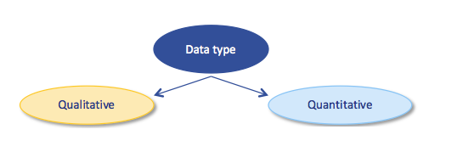
Qualitative vs Quantitative Data
  Qualitative Research is primarily exploratory research. It is used to gain an understanding of underlying reasons, opinions, and motivations. It provides insights into the problem or helps to develop ideas or hypotheses for potential quantitative research. Qualitative data collection methods vary using unstructured or semi-structured techniques.
  Quantitative Research is used to quantify the problem by way of generating numerical data or data that can be transformed into useable statistics. Quantitative Research uses measurable data to formulate facts and uncover patterns in research. Quantitative data collection methods are much more structured than Qualitative data collection methods.

Slide 6

Data analysis
A Process of Noticing, Collecting and Thinking
Data analysis is the process of breaking down, examining, comparing, conceptualizing, and categorizing data” (Strauss &
Corbin, 1998, p. 57), and to enable you to present what you have discovered to others. Analysis involves:
working with data,
organizing them,
breaking them into manageable units,
synthesizing them, searching for patterns,
discovering what is important and what is to be learned,
deciding what you will tell others.

Slide 7
The Process of Data Analysis
Once data collection has begun, it is time for the researcher to begin data analysis. Data analysis continues after data collection has been completed.
Polit and Beck (2006) describe qualitative data analysis as “challenging, labor-intensive, and guided by few standardized rules”.
the researcher explores the data to answer the questions: What is going on here? What does this mean? Why do the participants behave this way? And so on.

Slide 8
“A little bit of data and a lot of right brain- Agar, 1991”
The question is, how do you come up with that “little bit of data?”
Obviously you start by reading and rereading the data record. In the process you notice a few interesting things. You then collect one or more of these things and intensively think about them.

Slide 9
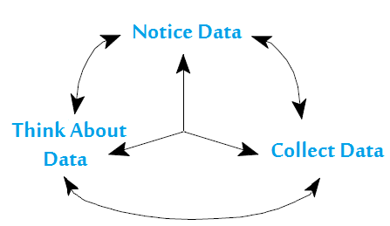
Data Analysis: A Model of the Process
Professor Ray Cuzzort was teaching an undergraduate statistics course and wanted to boil down the complexity of statistics to a simple model. His solution was to tell the students that statistics was a symphony based on two notes: means and standard deviations.
So to describe Data Analysis, the idea that QDA is a symphony based on three notes: Noticing, Collecting, and Thinking about interesting things (Seidel, 1998).

Slide 10
Noticing Means Making Observations, Writing Field Notes, Tape Recording, Interviews, Gathering Documents.
When You Do This You Are Producing A Record Of The Things
That You Have Noticed.
As you notice things in the record you name, or "code,” them.
Codes might start with: past symptoms, the decision to seek care, past problems with treatment
Your Goals Are:
To Make Some Type Of Sense Out Of Each Collection,
Look For Patterns And Relationships Both Within A Collection, And Also Across Collections,
To Make General Discoveries About The Phenomena You Are Researching.
When you identify piece, you are noticing and “coding” them.
When you sort the pieces you are “collecting” them.

Slide 11
Interpreting the Data
Once the data are sorted into manageable chunks through coding, the process of interpretation begins.
It is important to note that this phase of the research process overlaps with data collection and coding, although it often extends long after the data collection has been completed.

Slide 12
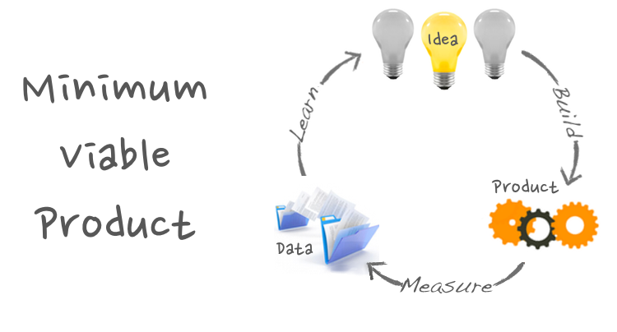
For most, the end products of research are books, papers, presentations, or plans for action. Data analysis moves you from the rambling pages of description to those products.

Slide 13
Negative Results: The Dark Matter of Research
The estimate for 2009 was 1.5 million articles, and that number is sure to be higher today. Still, the publication record is only a tiny slice of all the research data in existence around the world. Results that are inconclusive or challenge our assumptions are frequently hidden in lab notebooks, never to be shared. These data represent the “dark matter” of our research universe - the overwhelming majority of knowledge binding together the bright, shining, published articles.
But is the current system really best for science?

Slide 14
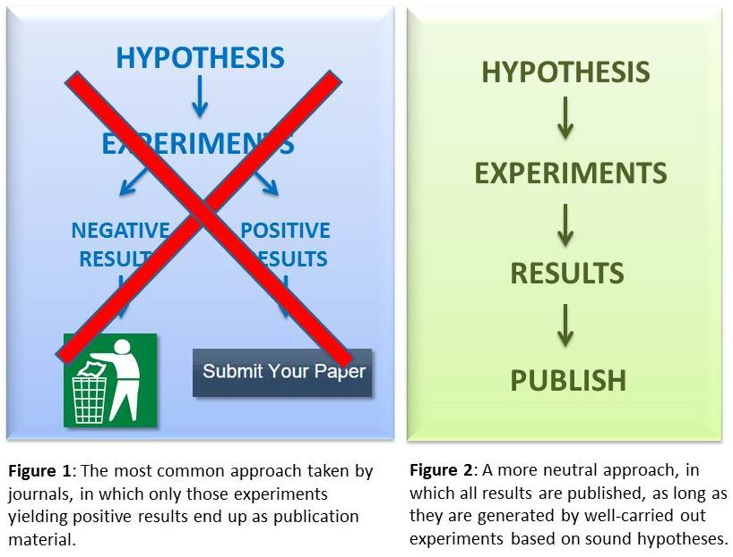
Reducing the positive bias in the scientific literature
One recurring misunderstanding among scientists is that negative results are equivalent to bad results and are products of flawed or ill-designed science.
This quality argument can be easily challenged, because even positive results are not exempted from having their quality questioned. Furthermore,, some of the most well-known examples of fraud and data fabrication in science were associated with studies claiming positive correlations or supporting researchers’ anticipated hypotheses.
Instead of suggesting poorly conducted science, negative results can indicate novel findings or unexpected outcomes of rigorous scientific investigations, directly or indirectly contributing to scientific discovery.

Slide 15
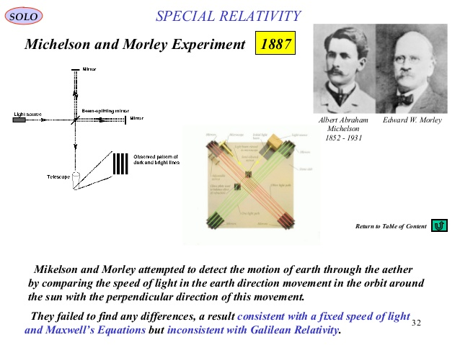
Example Of Negative Results
A classic example of negative results being recognized by researchers as scientific and ushering in a paradigm shift in science took place in the 17th century. All of their efforts to advance the theory led to a continual rejection of their research hypotheses. A few years later, these null results were published in the American Journal of Science and played an important role in inspiring new experiments, including a well known one that confirmed a major physical theory proposed by Albert Einstein in 1905: the special theory of relativity.

Slide 16
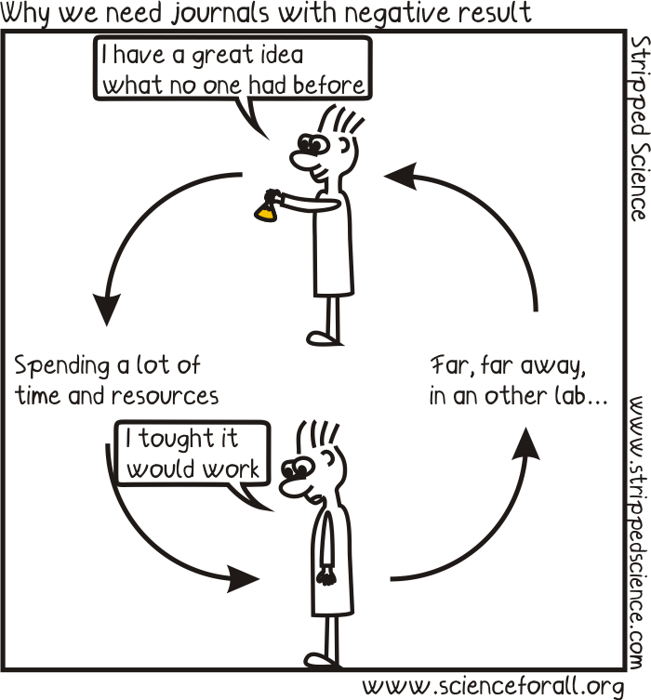
Why Science Needs to Publish Negative Results
The traditional journals are highly biased toward positive findings. As a consequence
Important negative findings often do not get reported.
Not knowing someone else has done the same experiment, the scientific community is at risk of spending time and money replicating failure rather than, as we do not do enough, replicating positive findings.

Slide 17
Should negative results be treated with the same rigor as positive results?
A negative finding may be important as it
argues against a specific hypothesis (these can and are sometimes published).
may support the null hypothesis.
But a negative finding can just as easily arise because the experiment was not done correctly, because it was poorly designed, because it was simply a bad idea in the first place.
However, interpretation of negative findings can be subject to the same problem that interpretation of positive findings are:
they can be over-interpreted, over-generalized, etc.

Slide 18

No result is worthless: the value of negative results in science
Fanelli (2012) demonstrates that negative results have been gradually disappearing from academic literature over the past two decades.
Meanwhile, articles primarily and clearly stating positive results have grown 22% between 1990 and 2007.
As positive results are more likely to lead to prestigious publications, discarding odd and unexpected findings is common in the scientific publishing system that privileges these “successful” results.
Traditionally, it is expected that successful studies will obtain research findings in alignment with well-established literature or expected outcomes.

Slide 19

Are Negative Results Indeed Meaningless? Or Is There Potential Value In Sharing Negative Results With A Broader Academic Community?
Reasons for the low profile of negative results publications, one common assumption is that publishing negative results might harm scientists’ reputations.
Along these lines, negative results are believed to indirectly communicate to the scientific community that a study was poorly designed and researchers were either unknowledgeable about the phenomenon or incapable of tailoring more robust research hypotheses.
Moreover, the discouragement to submit publications reporting negative results is due to a higher likelihood that these papers will be filtered by the peer-review firewall, given their perceived lack of soundness in comparison to studies with “successful” results.

Slide 20


Slide 21
Sufficient Statistics Is Important
Sufficient statistics are essential to allow critical evaluation of the interpretation of the data in the paper, for reviewers, readers, and future researchers who would conduct a meta-analysis of the published literature.
Definitions of sufficient statistics can be tediously technical for non-statisticians,, the general guideline is that enough information about the statistical analysis must be presented so that the interested reader could reconstruct the entire analysis.
For example, many authors report only p-values from an analysis of variance – this is not enough to reconstruct the complete anova table. There are many ways to report sufficient statistics – all of the f-values with numerator and denominator degrees of freedom and all error mean squares and degrees of freedom would be sufficient.

Slide 22
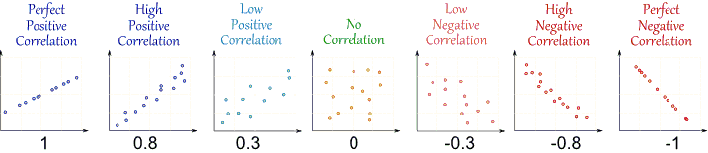
Correlation
Correlation can have a value:
1 is a perfect positive correlation
0 is no correlation (the values don't seem linked at all)
-1 is a perfect negative correlation
Absence of correlation as negative results between any 2 variables is very important as +ve and –ve correlation and must be interpreted and is worth publishing.

Slide 23
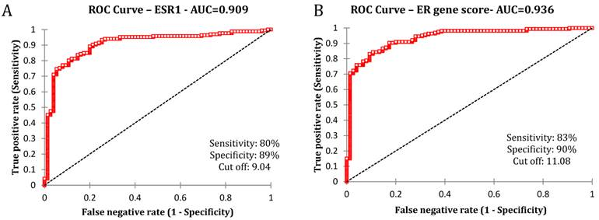
Receiver operating characteristic analysis
Estrogen receptor (ER) is an important prognostic and predictive marker in human breast cancer. Patients with tumors that are positive for ER are known to respond to endocrine therapy and have improved disease specific survival and overall survival compared to those with tumors that are ER negative.

Slide 24
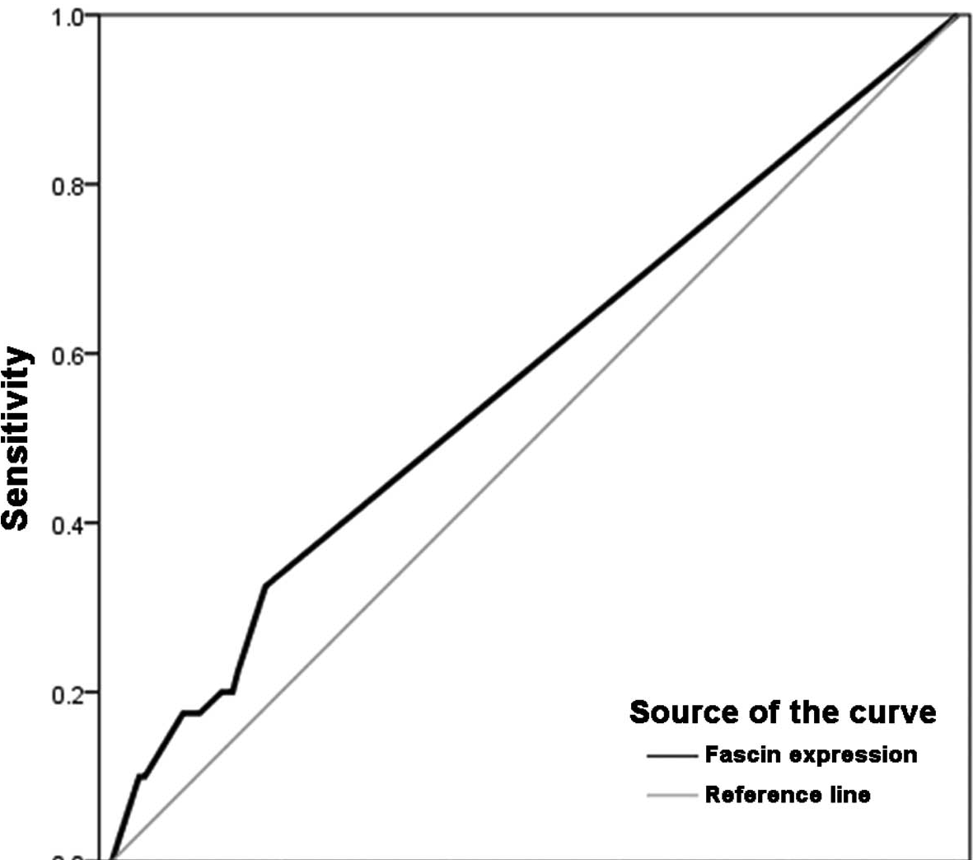
ROC curve for determination of the optimal cut-off value for fascin expression correlated with overall survival rate in patients with invasive ductal carcinoma of the breast (area under the ROC, 0.572). ROC, receiver operating curve.

Slide 25
Association studies of ACE gene polymorphism and recurrent miscarriage in different populations
Reference | Ethnicity | Genotype frequencies |  |  |  | Associations (main results)
 |  |  | DD n (%) | ID n (%) | II n (%)
Buchholz et al., 2003 | German | RM Case = 184 Control= 127 | 59 (32.1) 30 ( 23.6) | 83 (45.1) 71 (55.9) | 42 (22.8) 26 (20.5) | Significant association
Goodmanet al., 2009 | American | RM Case= 120 Control=48 | 34 (28.3) 28 (33.3) | 55 (45.8) 34 (40.8) | 31 (25.8) 22 (26.2) | No significant differences
Sallout et al, 2010 | Palestinians | RM Case=100 Control=100 | 49 49.0) 54 (54.0) | 42 (42.0) 34 (34.0) | 9 (9.0) 12 (12.0) | No significant differences
Zhang et al., 2011 | Chinese | RM Case=127 Control=132 | 21 (16.5) 8 (6.1) | 49 (38.6) 34 (25.8) | 57 (44.9) 90 (68.2) | Strong association
Mello et al., 2003 42 | Italian | RM cases = 48 | 25 (52) | 20 (42) | 3 (6) | Significant association.

Slide 26
Frequency of rs861539 (C/T) in XRCC3 different types of cancer in different populations.
rs861539 (C/T) Association of T allele
Breast cancer | Protective role | 100 | Saudis | This study
Colorectal cancer | Increased Risk (association) | 100 | Polish | 40
Breast Cancer | Increased Risk (association) | 1826 | UK | 2
Bladder Cancer | Protective Role | 214 | Italian | 42
Colerectal Cancer | Protective Role | 128 | British | 4
Lung Cancer | No association | 272 | Danish | 43
Breast Cancer | No association with cancer. Association with cancer progression and grading | 700 | Polish | 3

